Slide 1

Python Fundamentals
Course Introduction
SoftUni Team
Technical Trainers
Software University
https://softuni.bg/

Slide 2
Table of Contents
Course Objectives
Training Team
Course Organization
Course Schedule
Evaluation Criteria
2

Slide 3
Have a Question?
sli.do
#fund-python

Slide 4














SoftUni Diamond Partners

Slide 5

Educational Partners

Slide 6

Course Objectives

Slide 7
Python Fundamentals Objectives
Working with linear data structures
Lists
Defining functions and simple classes
Working with dictionaries
Processing and manipulating strings
Regular expressions
7

Slide 8

Training Team

Slide 9
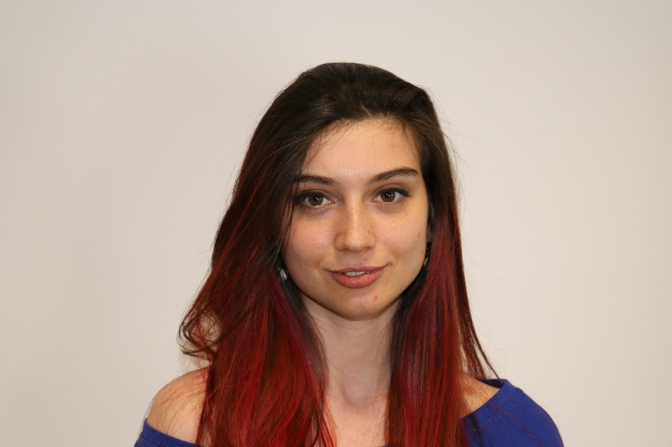
Ines Ivanova-Kenova
Senior Software Engineer at Nmible
Full stack freelance developer
Python, Django, Flask, FastAPI
C#, Angular
HTML, CSS
jQuery, Docker

Slide 10
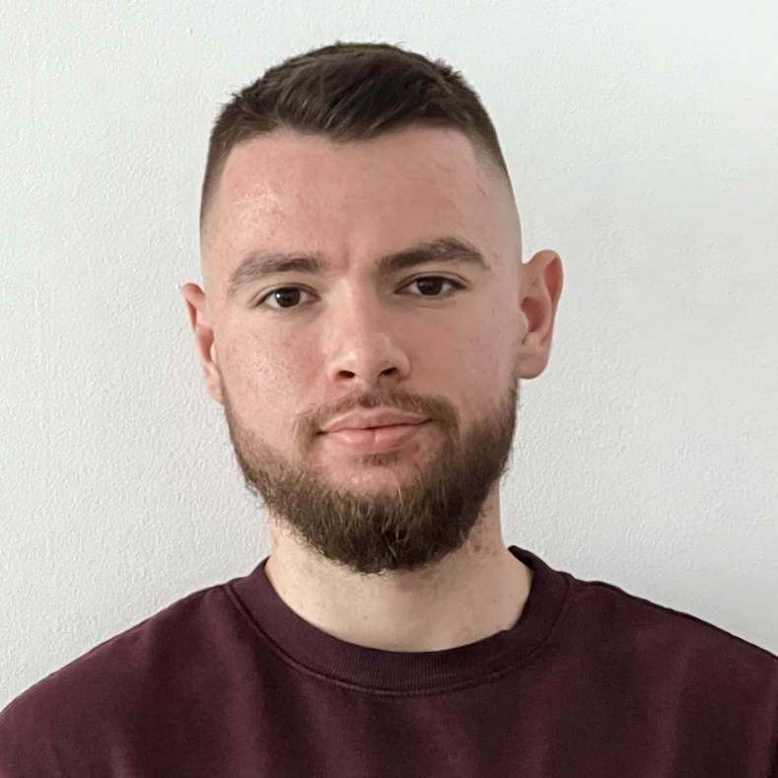
Atanas Atanasov
Software Engineer at Nexo
World's leading regulated digital assets institution
Created in Bulgaria
Technical Trainer at SoftUni
200+ training sessions for 4 years
Interested in the blockchain development
10

Slide 11

Course Organization

Slide 12
Python Fundamentals Module
09-Jan-2023
19-Feb-2023
02-Apr-2023
06-Apr-2023
10-Apr-2023
Python Fundamentals
12 weeks * 3 times/week
12 credits
Start: 09-Jan-2023
Mid Exam: 19-Feb-2023
Final Exam: 02-Apr-2023
Theoretical Exam: 02-Apr-2023
Re-Take Exams
Mid Exam Retake: 06-Apr-2023
Final Exam Retake: 10-Apr-2023
Theoretical Exam: 10-Apr-2023

Slide 13
Practical Programming Exam
Mid Exam - 4 hours
3 practical problems
Conditional Statements and Loops
Linear Data Structures – Lists
Final Exam - 4 hours
3 practical problems
Dictionaries
Strings and Text Processing
Regular Expressions
13

Slide 14
Theoretical Exam
You will have 30 minutes once you enter
Multiple-choice with 1 correct answer
Test will be in English
Automated quiz system
Available online on the day of the practical exam
You can submit your answers just one time
14

Slide 15
Course Scoring
Practice grade:
Theory grade:
SoftUni Certificate: 5.00 from Practice
CPE Certificate: 3.00 average from Practice + Theory
Practical Mid Exam
Practical Final Exam
Homework
40 %
60 %
+5 %
Theoretical Exam
100 %
15

Slide 16

Homework Assignments & Exercises
Your homework is mainly work in class
Lesson days → slides + live demos + exercises
Exercise days → only exercises
How to submit your homework?
Submitted in the judge system
Do your homework when it's due
Assignments pile up quickly

Slide 17


Learn to Search in Internet
The course assignments require to search in Internet
This is an important part of the learning process
Some exercises intentionally have no hints
Learn to find solutions!
Software development includes everyday searching and learning
No excuses, just learn to study!
Developers learn new technologies, tools, languages every day!

Slide 18



Course, Forum and FB Group
Official website:
Official discussion forum:
Official Facebook group:
Python Community Facebook group:
https://softuni.bg/trainings/3953/programming-fundamentals-with-python-january-2023
https://softuni.bg/forum/categories/784/python-fundamentals
https://www.facebook.com/groups/ProgrammingFundamentalsWithPythonJanuary2023
https://www.facebook.com/groups/SoftUniPythonCommunity

Slide 19
Questions?
Notes:
19

Slide 20
Trainings @ Software University (SoftUni)
Software University – High-Quality Education, Profession and Job for Software Developers
softuni.bg, about.softuni.bg
Software University Foundation
softuni.foundation
Software University @ Facebook
facebook.com/SoftwareUniversity
Software University Forums
forum.softuni.bg
Notes:
20

Slide 21

License
This course (slides, examples, demos, exercises, homework, documents, videos, and other assets) is copyrighted content
Unauthorized copy, reproduction or use is illegal
© SoftUni – https://softuni.org
© Software University – https://softuni.bg
Notes:
21

